Slide 1
Cooperative Decentralized Intersection Collision Avoidance Using Extended Kalman Filtering
MS Defense
Virginia Tech
December 5, 2008
Ashil Farahmand

Slide 2
Summary
Problems with intersection control devices
Proposed solutions
Our solution
Simulation results
Conclusions

Slide 3

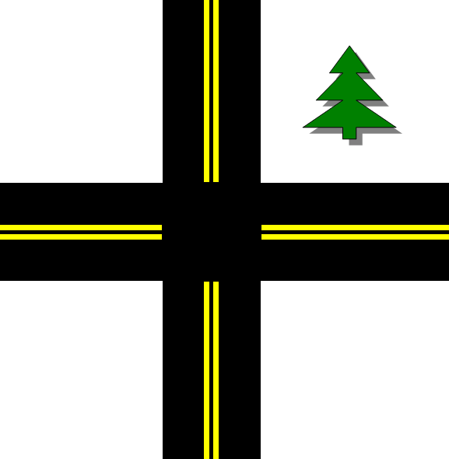

Problem
Notes:
We have 2 cars approaching an intersection; we want to devise a way to allow both cars to go through the intersection without colliding
Claims 40,000 lives annually in the US; substantial portion of these at intersections
One conventional solution is to install a stop sign

Slide 4


Limitations of Current Devices
Safety
Efficiency
Cost
Notes:
Emphasize
stop sign one car
and TS long line (to justify Opt) (perception, headway, and acceleration delay)

Slide 5
Other Proposed Solutions
Major Techniques:
  Radar
  Optical
  Cooperative

Slide 6

Other Proposed Solutions
Radar
  Car-Following
  Adaptive Cruise Control
Notes:
Radar/Lidar – what is it? How to determine if classified here?
[49-51] - Car-following and ACC

Slide 7
Other Proposed Solutions
Optical
  Pedestrian Detection
  Lane-Keeping
  Navigating Urban Environments
Notes:
Optical – what is it?
What is it used for?
[4][52] – Pedestrian Detection – Tsuji et al.; [5][53] – Lane-Keeping – Ulmer; [7][54] – Navigating Urban Environments – Gehrig et al.
What are it weaknesses? Doesn’t work well for Isections since no LOS

Slide 8
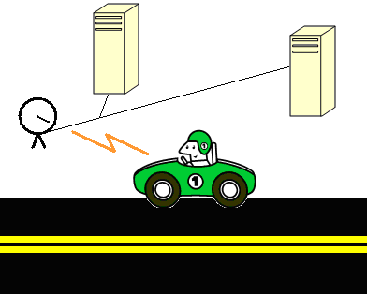
Other Proposed Solutions
Cooperative
  Blind Crossings
  Curved Roadways
Notes:
Cooperative – what is it?
What is it used for?
[8][60] – Blind Crossings - Li et al.; [9][62] – Curved Roads - Sung et al.
What are its weaknesses?

Slide 9
Our Proposal
A cooperative decentralized intersection collision avoidance system:
  Nonlinear state space vehicle model
  Coupled, constrained Extended Kalman Filter
  Wireless network for vehicular control
Notes:
We make 3 major contributions to the field of collision avoidance

Slide 10
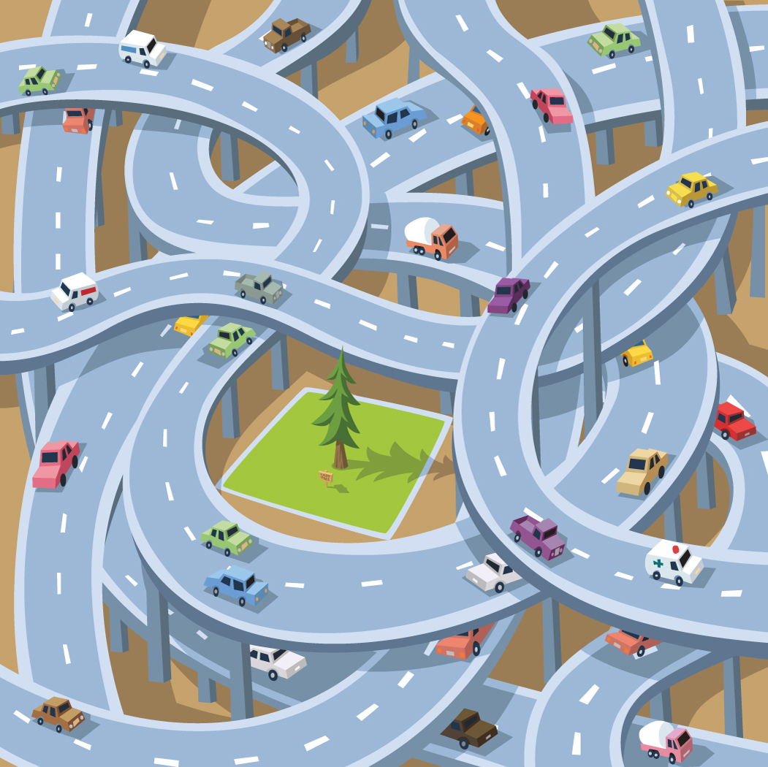
How Does the System Work?
Observe
Share
Estimate
Optimize
Automate
Notes:
Observe states of nonlinear vehicle model from GPS and internal vehicle sensors
Share state, control, and parameter information with all other vehicles
Derive filtered estimates using coupled EKFs
Use the filtered estimates to derive an optimal sequence of controls until intersection is traversed

Slide 11

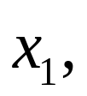



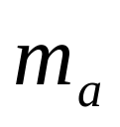


Nonlinear State Space Model
3 controls
  Throttle angle
  Brake angle
  Steering angle
5 states
  Position coordinates
  Mass of Air in the Intake Manifold
  Engine Angular Velocity
  Brake Torque
Notes:
- Model adapted from an earlier
- Assume 2 dims

Slide 12


Nonlinear State Space Model
losses
Notes:
- Note how ma and we are codependent

Slide 13
Nonlinear State Space Model
Why use a complex model? Why not use a tracker model?
  Accounts for state dependent frictional forces
  Yields optimization results in terms of vehicular controls

Slide 14
Coupled Extended Kalman Filter
What does it do?
How does it do it?
Why are we using it?
Estimates vehicle trajectories
Predicting and Filtering
To provide good estimates to the optimization algorithm
Notes:
Estimates the dynamics of nonlinear systems
At each time step, it predicts the next state, receives a noisy observation, then computes a filtered estimate of the next state

Slide 15
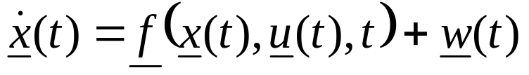
Coupled Extended Kalman Filter
Nonlinear State Equation
Nonlinear Observation Equation
Assumptions:
  f and h
  u
  w and e
  z
Notes:
Coupled EKF is derived by putting nonlinear eqns into vector-matrix form, then lumping successive vehicle equations into 1 vector
Assumptions:
f and h cont and cont diff wrt to all x and u;
u is known and does not change over one time interval
w and e are independent, white, normally-distributed RVs
observations made at discrete intervals and all states are directly observed since states are codependent

Slide 16
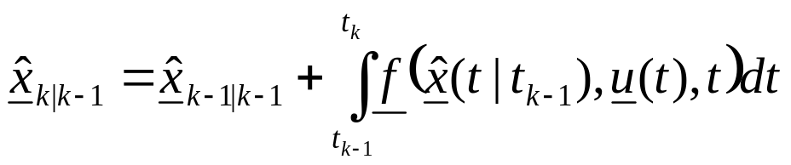
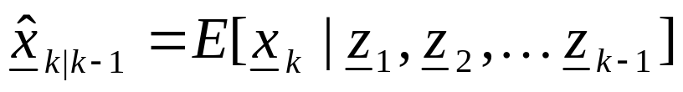
Coupled Extended Kalman Filter
Predicted Estimate
Satisfies:
How is it applied to the vehicle model?
  4th order Runge-Kutta Method
  Constrained
Notes:
The next state is predicted by integrating the state equations from the last corrected estimate to the next time step
Under Gaussianity, it is the best possible estimate in the maximum-likelihood sense since it minimizes the MSE of the prediction
Since no analytical solution to nonlinear vehicle equations, RK4 method is used to approximate integral
The state estimates are constrained to be > 0 (predicted and filtered)
The EKF frequency is chosen to be 1 kHz to ensure safety

Slide 17
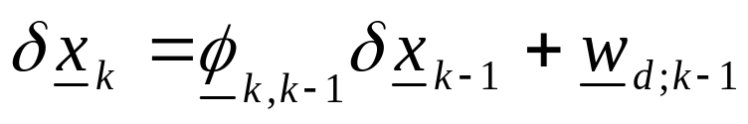
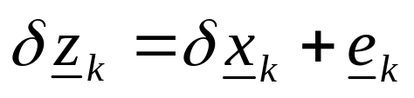
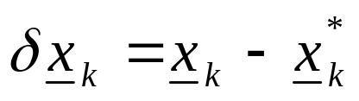
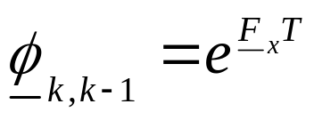
Coupled Extended Kalman Filter
Discretized Linear Perturbation State Equation
Discretized Linear Perturbation Observation Equation
Notes:
We want to be able to use the classical KF eqns for nonlinear systems so we:
Use a 1st-order TS expansion to linearize and discretize the nonlinear equations to derive a set of linear, perturbation eqns
We linearize around the nominal values which are the previous filtered estimates

Slide 18
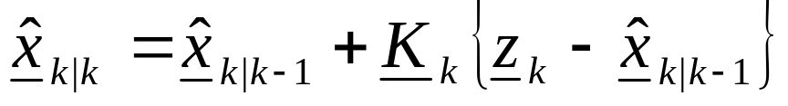
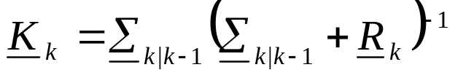
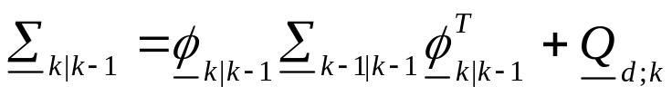
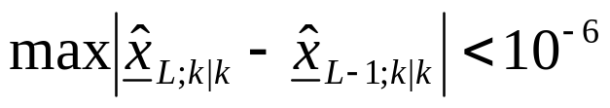
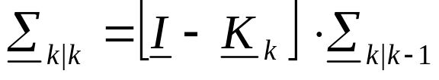
Coupled Extended Kalman Filter
Filtered Estimate
Iterate until:
Updated State Error
Notes:
After receiving the observation, the filtered estimate is derived
- Iterating filtering step

Slide 19
Vehicle Network
Dedicated Short Range Communications (DSRC)/Wireless Access in the Vehicular Environment (WAVE)
  IEEE 1609 Suite and 802.11p Standards
  Long range – 1 km
  Low latency – 50 ms
  Low interference – Uses dedicated frequency
  High bandwidth - 75 MHz at 5.9 GHz
  High data rate at high vehicle speeds – 6-27 Mbps at up to 100 MPH
Notes:
Specially designed to support critical applications

Slide 20
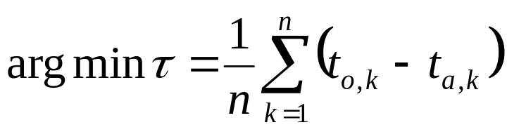
Optimization: Sparse Traffic
Operation emulates a yield sign
Objective Function:
Constraints:
Assumptions:
  Fully-Meshed Network
  Fewer than 6 vehicles
  Clear weather conditions (no rain, etc.)
  No pedestrians, no debris
Notes:
- The size of the vehicle radii should be dependent on the weather

Slide 21
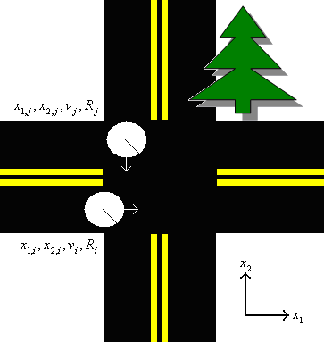
Optimization: Sparse Traffic

Slide 22


Optimization: Sparse Traffic
The Sparse Traffic Optimization Algorithm iterates as follows:
  Determine a vehicle order
  For each vehicle according to order:
    Find sequence of controls and
    If, a collision occurs with a higher ordered vehicle, iteratively:
      Brake until initial velocity is reduced a certain amount
      Find sequence of controls and
  - Once all possible vehicle orderings have been tested, the optimal vehicle ordering and controls are selected
Notes:
Acc @ 85
Brake @ 4 m/s^2 before turning according to Garber
Turn uniformly
Acc @ 85

Slide 23
Optimization: Sparse Traffic
Why a maximum of 5 vehicles?
  Network interference
  Rapidly increasing processing times
What happens when more vehicles are added?
  Dense Traffic Optimization Algorithm

Slide 24
Optimization: Dense Traffic
Similar to a traffic signal
Forms hierarchical network
Composed of 5 steps:
  Assign Roles
  Assign Approach Priorities
  Determine Time Request for Each Approach
  Schedule Time for Each Approach
  Vehicles Cross Intersection According to Schedule
Notes:
- Minimizes interference by making a hierarchical network

Slide 25
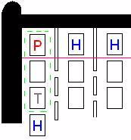
Optimization: Dense Traffic
1. Assign Roles
P – Primary
H – Head
T - Tail
Notes:
- Tails not assigned yet

Slide 26
Optimization: Dense Traffic
2. Assign Approach Priorities
- based on position and speed of primaries
3. Determine Time Request for Each Approach
- Each Head determines preliminary time for lane
- Heads send preliminary times to their primary
- Primaries calculate average and maximum times of their approach’s preliminary times and share them
- Primaries share with their Heads
Notes:
- Primaries that

Slide 27
Optimization: Dense Traffic
4. Schedule Time for Each Approach
- Using priority information, each Head schedules an amount of time for each approach to cross the intersection
- Heads share schedule with cars in their lanes
- Cars form platoons (Tails assigned)
- Cars independently determine controls to meet constraints
5. Cross Intersection
- Heads of next scheduled approach proceed to cross intersection once confirmation from the Tail of the current approach is received
Notes:
Schedules will be consistent since shared global knowledge of intersection
Acceleration and time constraints

Slide 28

Simulation Results
Lets compare the delay caused by a Stop Sign against the STOA at a normal, 4 approach intersection
  One vehicle
  In 25 and 45 MPH zones
Notes:
- 4 m/s^2 braking, acc = 85, R = 2m, vi = 5 MPH above limit

Slide 29

Simulation Results
Lets compare the delay caused by a Traffic Signal against the STOA at a normal, 4 approach intersection with a 2-phase, fully-actuated signal that has not transitioned in a long time
  One vehicle
  In 25 and 45 MPH zones with 4 and 5 second yellow intervals respectively
Notes:
4 m/s^2 braking, acc = 85, R = 2m, vi = 5 MPH above limit
If not long time, must wait for green interval as well

Slide 30
Simulation Results
Lets compare the traffic signal to the DTOA by analyzing the number of vehicles that can traverse the intersection in one green cycle
  Infinite number of vehicles at all approaches
  Vehicles each have 4 m length and 1 m separation
  Vehicles are limited to 30-MPH speed
  Assume 1 sec perception and separation delays for human drivers
Notes:
4 m/s^2 braking, acc = 85, R = 2m, vi = 5 MPH above limit
If not long time, must wait for green interval as well

Slide 31
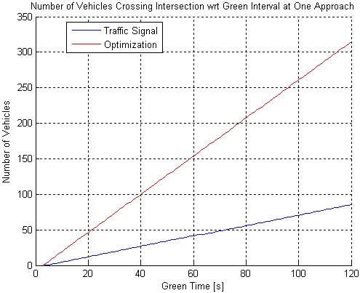
Simulation Results

Slide 32
Conclusions
We have proposed a cooperative decentralized intersection collision avoidance system that makes 3 major contributions:
  A nonlinear state space vehicle model
  A coupled, constrained, Extended Kalman Filter
  A wireless network for vehicular control

Slide 33
Conclusions
The system is an improvement of current intersection control devices in terms of:
  Safety
  Efficiency
  Cost

Slide 34
Thank You
?

Slide 35
Future Research
Determine threshold between sparse and dense algorithms
Further develop DTOA
Integrate optical camera with cooperative system

